Slide 1
Generative Adversarial Network
1

Slide 2
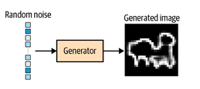
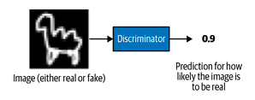
GAN is a battle between two adversaries, the Generator and the Discriminator.
Generator (G): “Can I create fake images that look real?”
Discriminator (D): “Can I tell real images from fake ones?”

Slide 3
Discriminator training
What goes into the discriminator?
Two kinds of images in the same batch:
Real images from the dataset → label 1
Fake images produced by the generator → label 0
Binary classification problem.

Slide 4
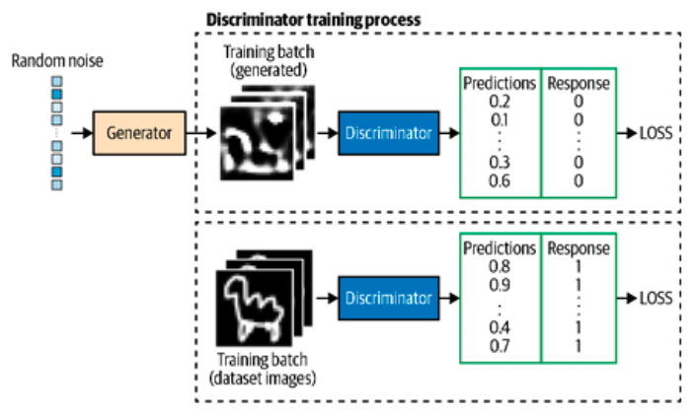
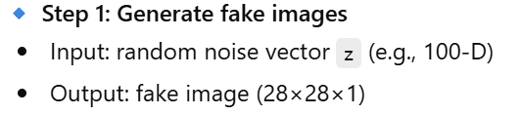

Slide 5
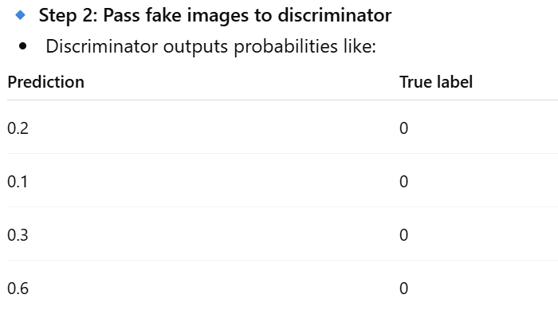

Slide 6
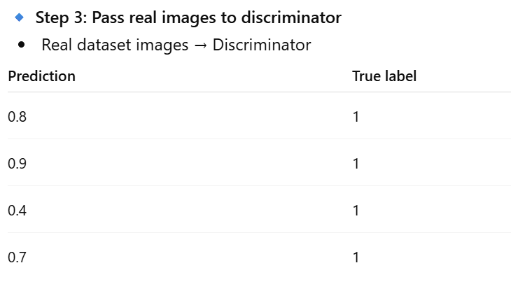

Slide 7
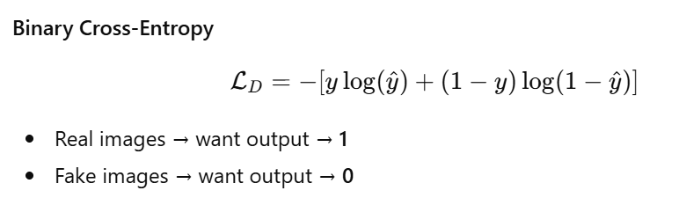
Loss used
Only discriminator weights are updated here
The weights are the trainable parameters of the neural network that produces $\hat{y}$

Slide 8
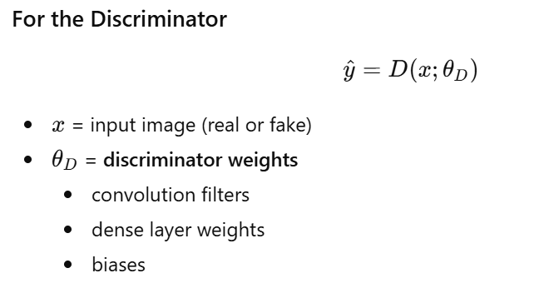
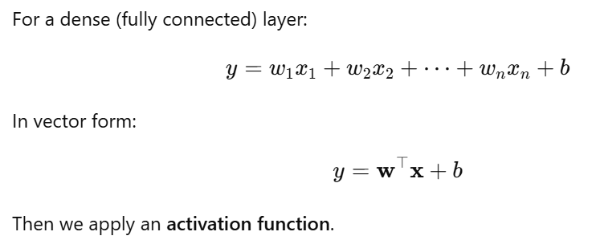

Slide 9
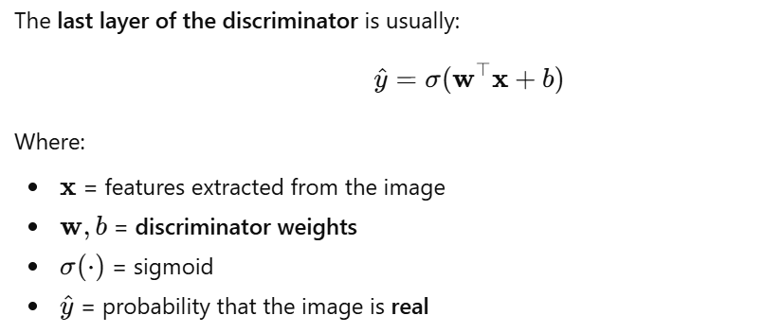

Slide 10
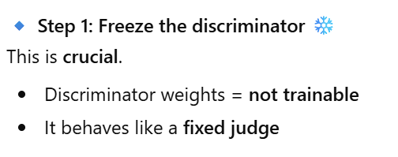
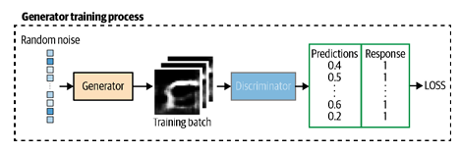
Generator training
We want the generator to improve, not the discriminator

Slide 11
Step 2: Build a combined model
z → Generator → fake image → Discriminator → probability

Slide 12
Step 3: Set target labels = 1
Prediction | Target
0.4 | 1
0.5 | 1
0.6 | 1
0.2 | 1
“The label 1 is artificial and is used only to define the loss; it does not represent a true ground-truth label.”
Why label = 1?
Because the generator’s goal is:
“Make the discriminator believe these are real images.”

Slide 13
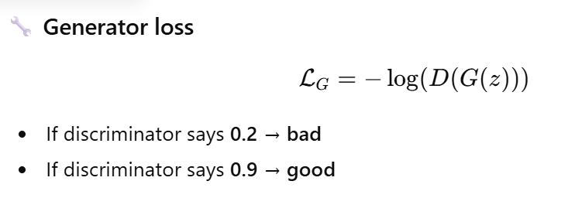
Backpropagation flows like this:
loss → discriminator (frozen) → generator (updated)

Slide 14
The Min-Max Loss Function
Ultimately, the adversarial nature of GANs creates a Min-Max Game, leading to the final loss function:
The discriminator tries to maximize this function by correctly classifying real and fake data.
The generator tries to minimize it by generating realistic samples that fool the discriminator.

Slide 15
“In practice, the generator is trained using a modified (non-saturating) loss to avoid vanishing gradients, while the discriminator follows the original objective.”
Feature | Saturated (Minimax) Loss | Non-Saturated (NS) Loss
Generator Goal | Minimize ( \log(1 - D(G(z))) ) | Maximize ( \log(D(G(z))) )
Alternative Form | — | Minimize ( -\log(D(G(z))) )
Gradient Strength | Vanishes when Discriminator (D) is strong | Stronger gradients, especially in early training
Training Stability | Often low; easily gets stuck (vanishing gradient problem) | More stable convergence
Best Use Case | Mainly theoretical analysis (original GAN formulation) | Practical GAN training (used in most implementations)

Slide 16
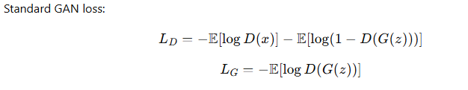
GAN Challenges
1. Oscillating Loss
The loss of the discriminator and generator can start to oscillate wildly, rather than exhibiting long-term stability.

Slide 17
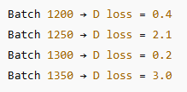
During GAN training, instead of the loss:
Slowly decreasing
Slowly increasing
Or stabilizing around some value
it starts jumping up and down unpredictably.
That behaviour indicates instability.

Slide 18
Typically, there is some small oscillation of the loss between batches…
This is normal.
Because:
Each batch contains different data
GAN is adversarial (G and D fight each other)
So small fluctuations are expected.
But they should be controlled, not explosive.

Slide 19
“…but in the long term we should be looking for loss that stabilizes or gradually increases or decreases…”
Over many batches or epochs, the overall trend should show:
Stabilization (loss plateaus)
Gradual improvement
Some equilibrium between G and D
This indicates the GAN is learning properly.

Slide 20
“…rather than erratically fluctuating, to ensure your GAN converges and improves over time.”
If loss fluctuates randomly with no pattern:
The model is not converging.
The generator is not improving steadily.
Training may collapse later.
GAN convergence means:
Neither G nor D dominates completely.
They reach a balanced competition.

Slide 21
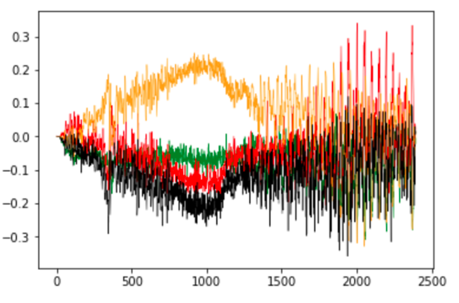
Figure shows an example of a GAN where the loss … has started to spiral out of control, at around batch 1,400.
This means:
Training may look stable initially.
But after many batches (like 1400), something destabilizes:
Learning rate too high
D becomes too strong
Gradient explosion
Then loss suddenly becomes chaotic.
This is common in GANs.

Slide 22
This is important.
GAN do not guarantee convergence.
GAN have unstable minimax optimization.
GAN can suddenly destabilize even after appearing stable.
so you cannot always predict when instability will happen.
Small fluctuations in GAN loss are normal. But if the loss starts jumping wildly and uncontrollably, your GAN training has become unstable. GANs are especially prone to this problem, and it can happen unpredictably.

Slide 23
2. Mode Collapse
“Mode collapse occurs when the generator finds a small number of samples that fool the discriminator…”
In a GAN, the generator (G) should learn the entire data distribution.
Example: If training data = handwritten digits (0–9), the generator should produce all digits, not just one.
But in mode collapse, the generator discovers:
one digit
So it keeps producing only that type.
Example:
Instead of generating many different faces,
It keeps generating almost the same face with minor variations.

Slide 24


“…and therefore isn’t able to produce any examples other than this limited set.”
The generator becomes stuck.
It maps many different latent vectors z to the same output image.
Mathematically:
Instead of:
It becomes:
So diversity disappears.

Slide 25
Suppose we train the generator over several batches without updating the discriminator…
GAN training must alternate:
Update D
Update G
Update D
Update G
If we update G too many times:
The generator over-optimizes to fool the current discriminator.
The discriminator becomes outdated.
This leads to shortcut learning.

Slide 26
“…and would start to map every point in the latent input space to this observation.”
Latent space normally:
z∼N(0,1)
Different z values should generate different outputs.
But in mode collapse:
G(z) = x* for many z
So the latent space loses meaning.

Slide 27
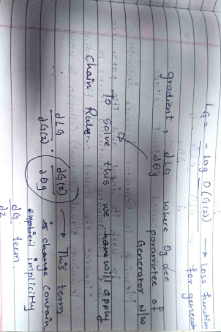
“This means that the gradient of the loss function collapses to near 0.”

Slide 28
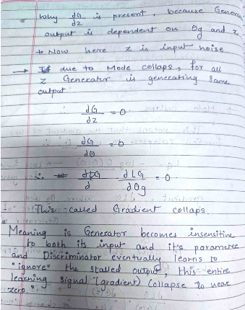

Slide 29
“Even if we then retrain the discriminator… the generator will simply find another mode…”
Here’s the dangerous cycle:
G finds one fake sample that fools D.
D learns to detect it.
G finds another single trick.
D adapts again.
Instead of learning full distribution, they keep playing a cat-and-mouse game over individual samples.
This is not convergence — it’s cycling between few modes.

Slide 30
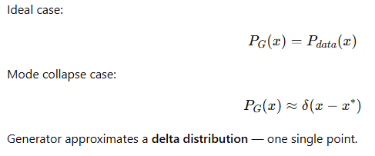

Slide 31
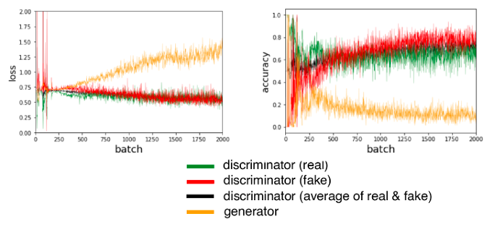
3.Uninformative Loss
Since the Generator is compiled to minimize the loss function, it would be natural to think that the smaller the loss function of the generator, the better the quality of the images produced.
However, since the generator is only graded against the current discriminator and the discriminator is constantly improving, we cannot compare the loss function evaluated at different points in the training process.
Indeed, in Figure, the loss function of the generator actually increases over time, even though the quality of the images is clearly improving.
This lack of correlation between the generator loss and image quality sometimes makes GAN training difficult to monitor.

Slide 32
Hyperparameters
As we have seen, even with simple GANs, there are a large number of hyperparameters to tune.
As well as the overall architecture of both the discriminator and the generator, there are the parameters that govern the batch normalization, dropout, learning rate, activation layers, convolutional filters, kernel size, striding, batch size, and latent space size to consider.
GANs are highly sensitive to very slight changes in all of these parameters, and finding a set of parameters that works is often a case of educated trial and error, rather than following an established set of guidelines.

Slide 33
Optimization Algorithm
Even with the same dataset and model architecture, using different optimization algorithms can lead to completely different training results.

Slide 34
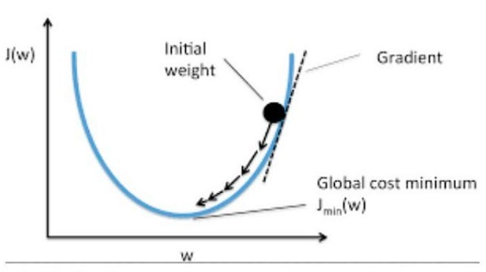
SGD - Stochastic Gradient Descent
Stochastic Gradient Descent (SGD) is one of the most fundamental optimization algorithms used in machine learning.
It minimizes a loss function by iteratively updating model parameters in the opposite direction of the gradient of the loss, computed using a randomly selected data point (or a small batch of data).
If I change this parameter slightly, how will the loss change?
Why “stochastic”?
Instead of computing the gradient using the entire dataset (as in batch gradient descent),
SGD uses one randomly chosen sample (or a mini-batch),

Slide 35
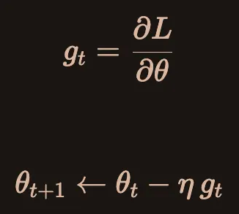
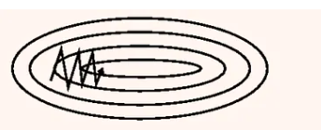
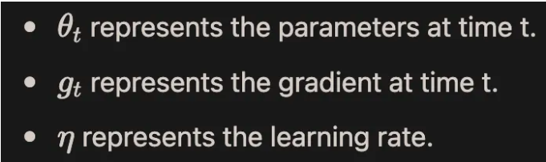
noisy zig-zag, slow convergence

Slide 36
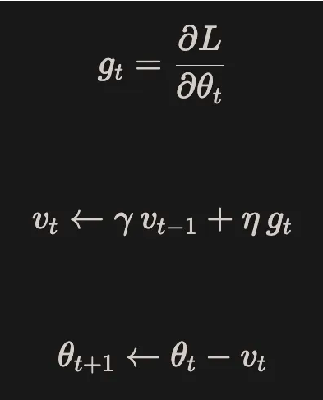
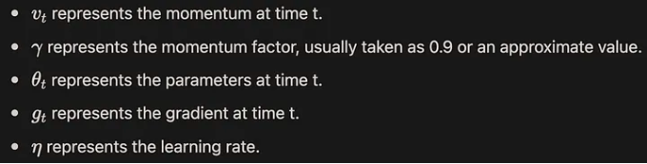
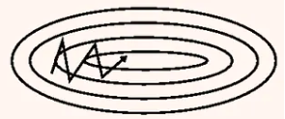
SGD with momentum
smooth trajectory, faster convergence

Slide 37
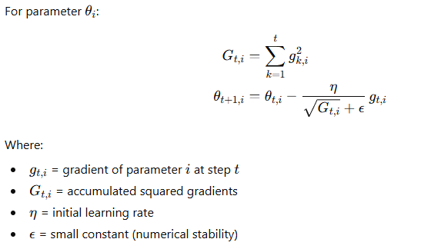
AdaGrad (Adaptive Gradient Algorithm)
AdaGrad is an optimization algorithm that adapts the learning rate for each parameter individually based on the history of gradients.
Parameters that receive large gradients frequently → get smaller learning rates
Parameters that receive small or rare gradients → get larger learning rates

Slide 38
RMSProp
RMSProp divides the gradient by a running average of recent squared gradients, preventing the learning rate from decaying to zero.
Therefore, RMSprop uses exponential moving average to slowly discard previous gradient history. This prevents the learning rate from decreasing too early.
The method to calculate the exponential moving average of the squared gradient is as follows, where γ is the forgetting factor (or exponential decay rate), which is typically set to 0.9 based on empirical evidence:

Slide 39
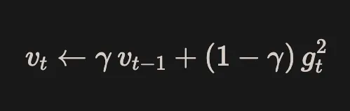
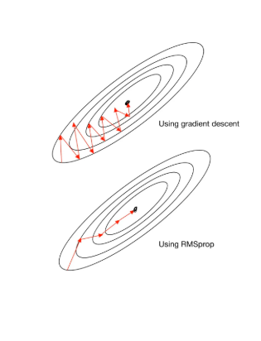
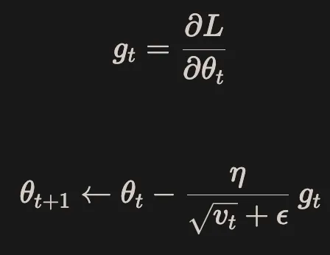
The parameter updating method is similar to adagrad:

Slide 40
Adam (Adaptive Moment Estimation)
Adam (Adaptive Moment Estimation), proposed in December 2014, is an optimization algorithm that combines the benefits of AdaGrad and RMSProp.
It computes adaptive learning rates for each parameter by maintaining exponentially decaying averages of the first-order moment (mean of gradients) and the second-order moment (uncentered variance of gradients), which are then used to determine the parameter update.

Slide 41
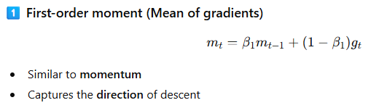
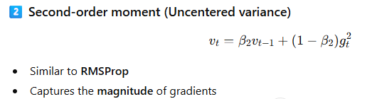
Adam keeps track of two running statistics:

Slide 42
